Slide 1

Proteomics Data Ecosystems
Michael MacCoss
Department of Genome Sciences
University of Washington

Slide 2
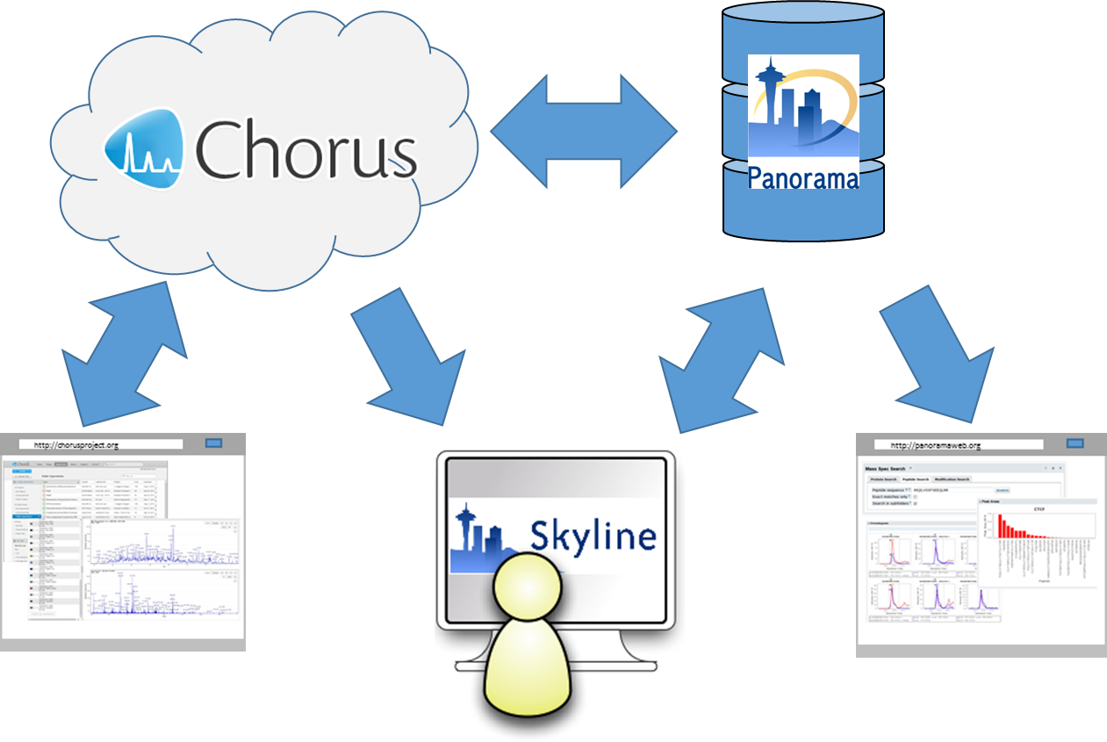
Creating an Ecosystem of Tools for Data Management and Analysis

Slide 3
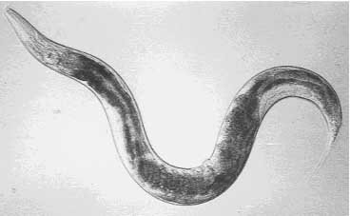
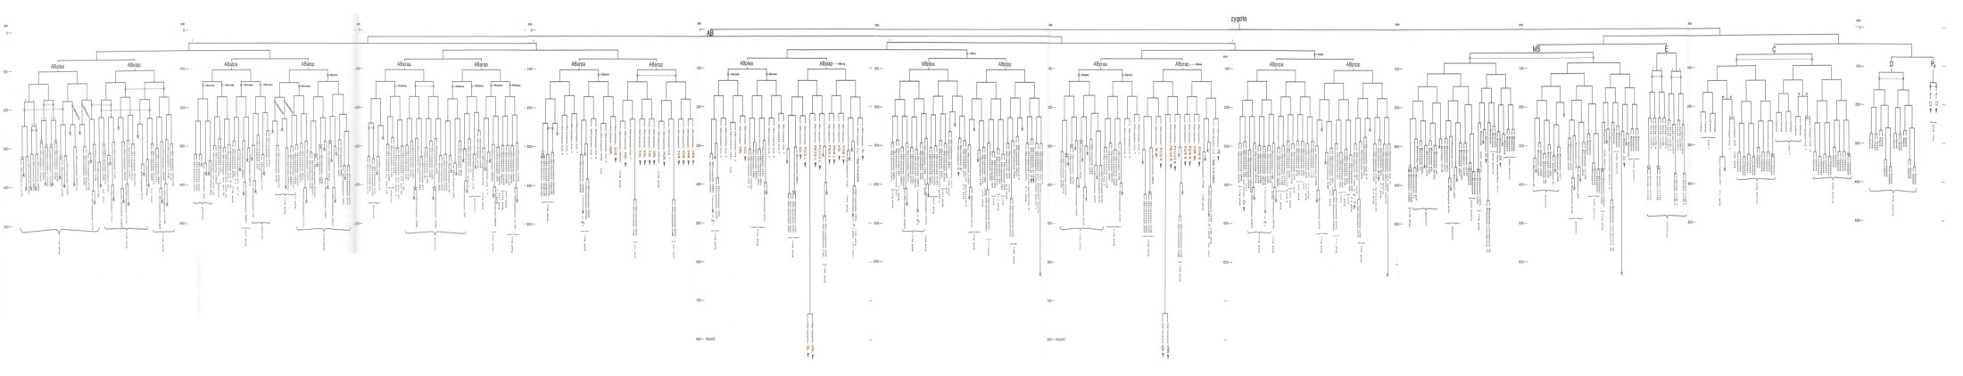
C. elegans as an In Vivo Model System for Proteomics
The only multicellular organism with a genome sequenced to completeness
Complete Lineage for all 959 Somatic Cells
Done by Gennifer Merrihew

Slide 4
Humans
C. elegans
Insulin Receptor
DAF-2
IRS1-4
IST-1
pi 3-kinase
AGE-1
PDK1
PDK-1
AKT/PKB
AKT-1/AKT-2
FKHR
FKHRL1
AFX
DAF-16

Slide 5
C. elegans as an In Vivo Model System for Proteomics
Soluble Proteins
Insoluble Proteins
0 Proteins Identified that are Known to be Involved in the Insulin / IGF-1 Signaling Pathway
Reversed Phase 10 Fractions
(NH₄)₂SO₄ Cuts 8 Fractions
Density Centrifugation 10 Fractions
10 MudPITs
8 MudPITs
10 MudPITs
>6,000,000 MS/MS Spectra, 67,047 Unique Peptide Identifications, and 6,779 Unique Protein Identifications

Slide 6
Would it be better to take a targeted approach?

Slide 7
Q1
CID
Q3
Ion Source
521.7
757.6

Slide 8
Precursor Ion > Product Ion
TGASEAVPSEGK > GK
TGSAEAVPSEGK > EGK
TGSAEAVPSEGK > SEGK
TGSAEAVPSEGK > PSEGK
TGSAEAVPSEGK > VPSEGK
TGSAEAVPSEGK > AVPSEGK
TGSAEAVPSEGK > EAVPSEGK
TGSAEAVPSEGK > AEAVPSEGK
TGSAEAVPSEGK > SAEAVPSEGK
SRM Chromatograms
y2
566.78 > 204.13
y3
566.78 > 333.18
y4
566.78 > 420.21
y5
566.78 > 517.26
y6
566.78 > 616.33
y7
566.78 > 687.37
y8
566.78 > 816.41
y9
566.78 > 903.44
y10
566.78 > 1031.5

Slide 9
IDATTHIGGVQIK DAF-16
QEDVVIEGWLHK AKT-1
Worm Homogenate
75 attomole IDATTHIGGVQIK
7.5 femtomole QEDVVIEGWLHK
Synthetic Peptide Standards

Slide 10
The Challenge:
In 2006, software for building targeted proteomics methods didn’t exist.
Neither did software for the analysis of complex multiplexed SRM methods
No software was capable of cross vendor data analysis

Slide 11
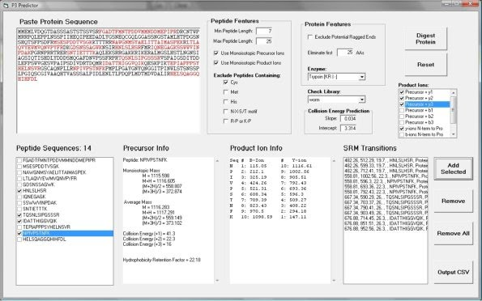
P3 Predictor
Problems:
Software was simplistic
One protein at a time
Could only generate methods
Impossible to maintain and expand

Slide 12

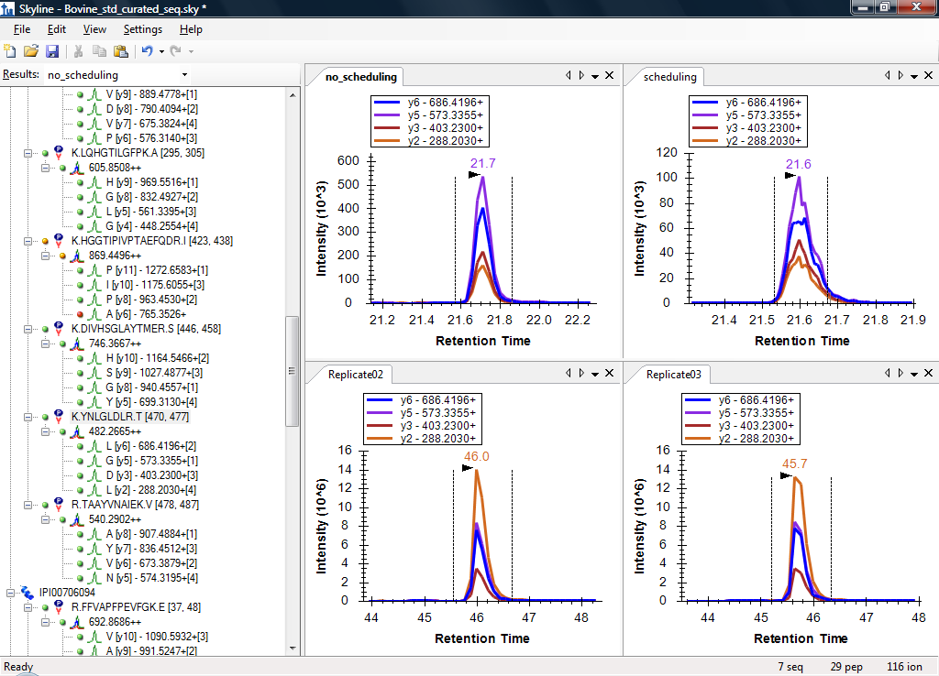
Skyline: Software for the Development of Targeted Proteomics Methods and Analysis of the Data
Needs:
Protein and Peptide centric
Intuitive document editor graphical interface
Full undo/redo support
Direct analysis of all vendor RAW MS data without conversion.
Ability to choose peptides and transitions based on peptide spectrum libraries
Free and open source
Developed and supported professionally
http://skyline.maccosslab.org

Slide 13
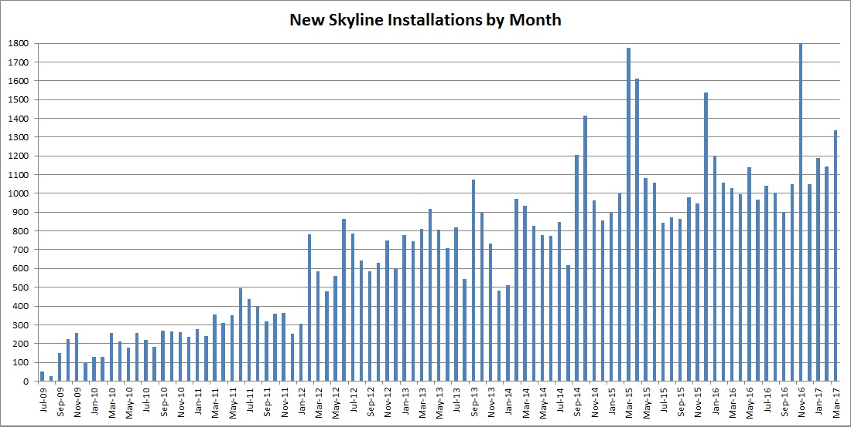
Over 65,000 Skyline Installations

Slide 14
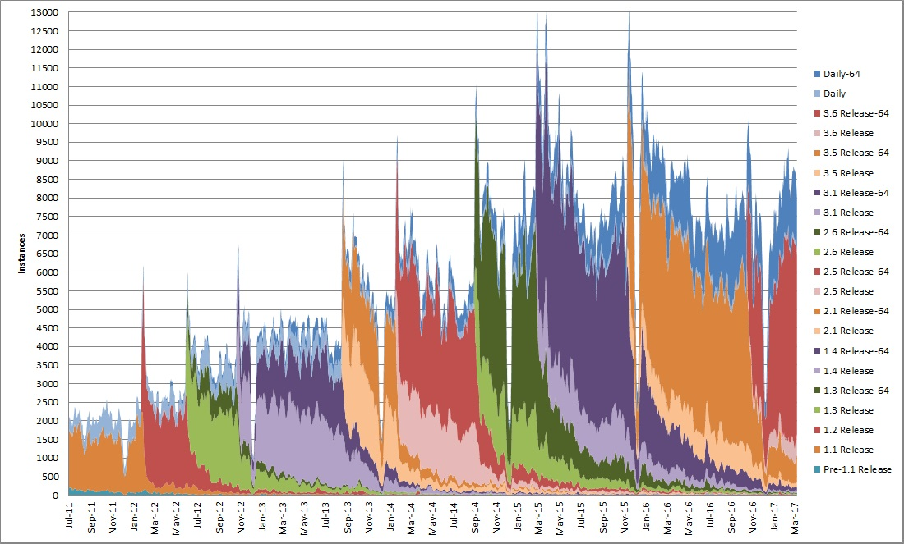
Skyline Startups Per Week

Slide 15






Skyline is Vender Neutral
Paulovich Lab Applied Biosystems QTrap 4000
MacCoss Lab Thermo TSQ Ultra

Slide 16
Skyline is Not Just for SRM
Support Targeted Quantitation from Extracted Ion Chromatograms:
Selected Reaction Monitoring (aka SRM and MRM)
Targeted MS/MS (aka Parallel Reaction Monitoring or HMRM)
MS1 Filtering (chromatogram extraction from the MS1 data)
Data Independent Acquisition and SWATH

Slide 17
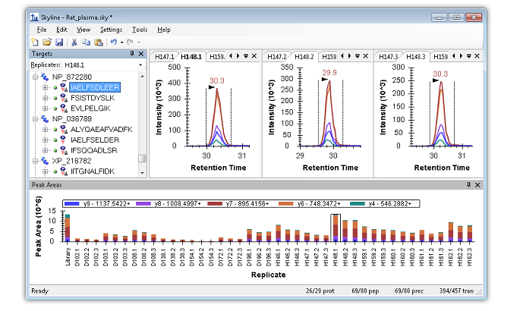
Immediate Visual Interaction with the Data
129 peptides, 42 replicates

Slide 18
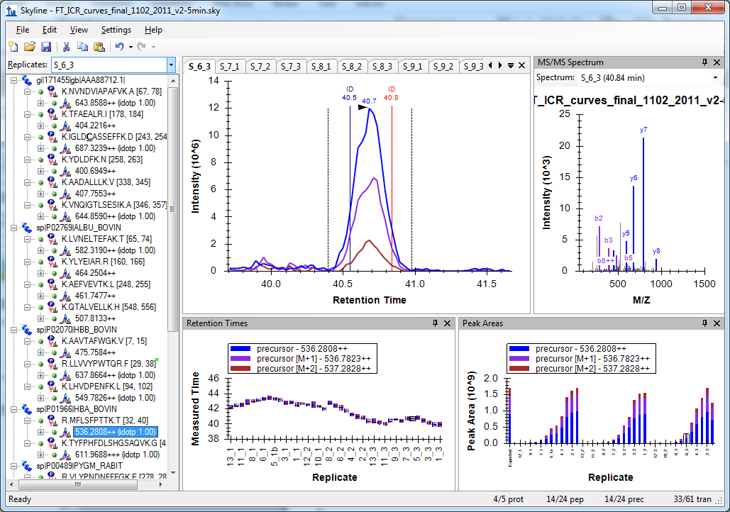
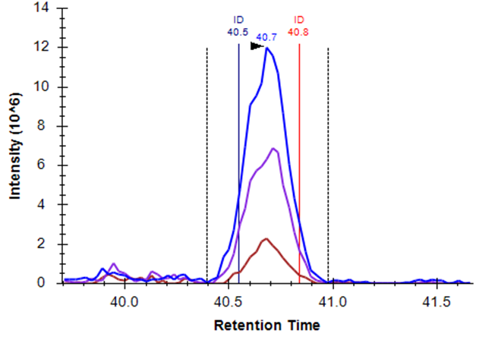
Skyline MS1 Filtering Data
Schilling, B. et al. Mol. Cell. Prot. 2012.

Slide 19
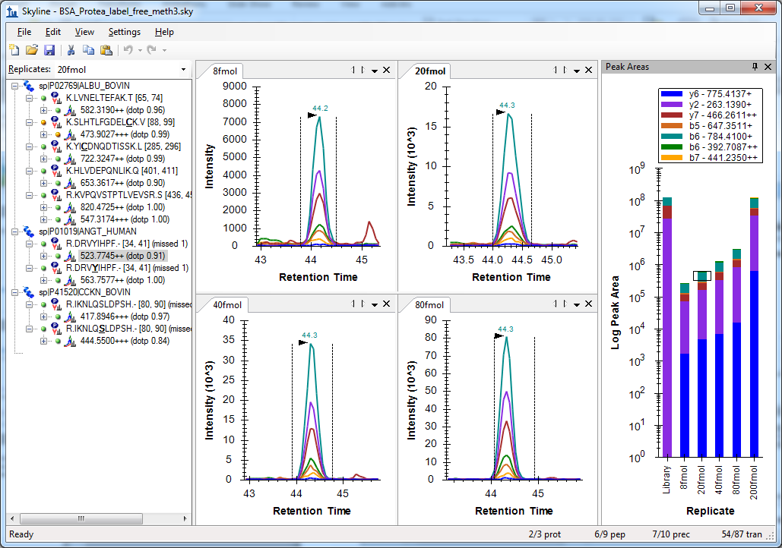
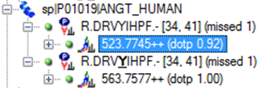
Skyline Targeted MS/MS
Sherrod, S. et al. J. Prot. Res. 2012.

Slide 20
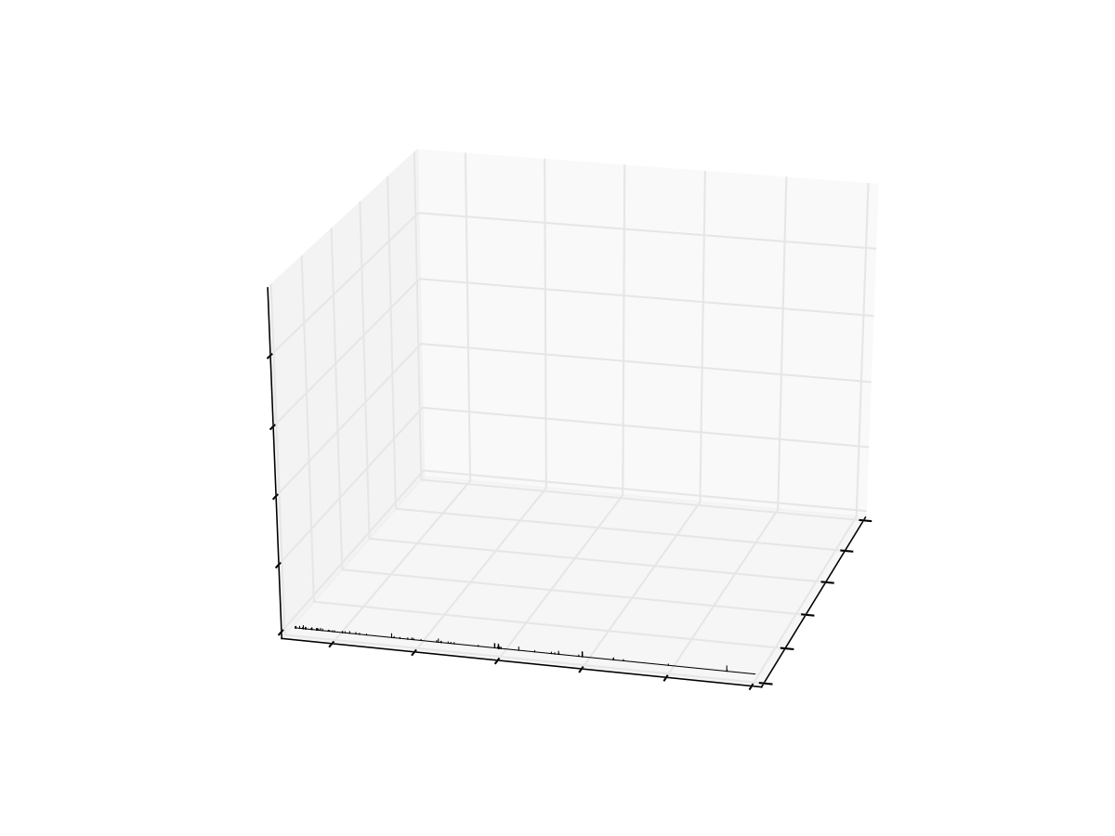
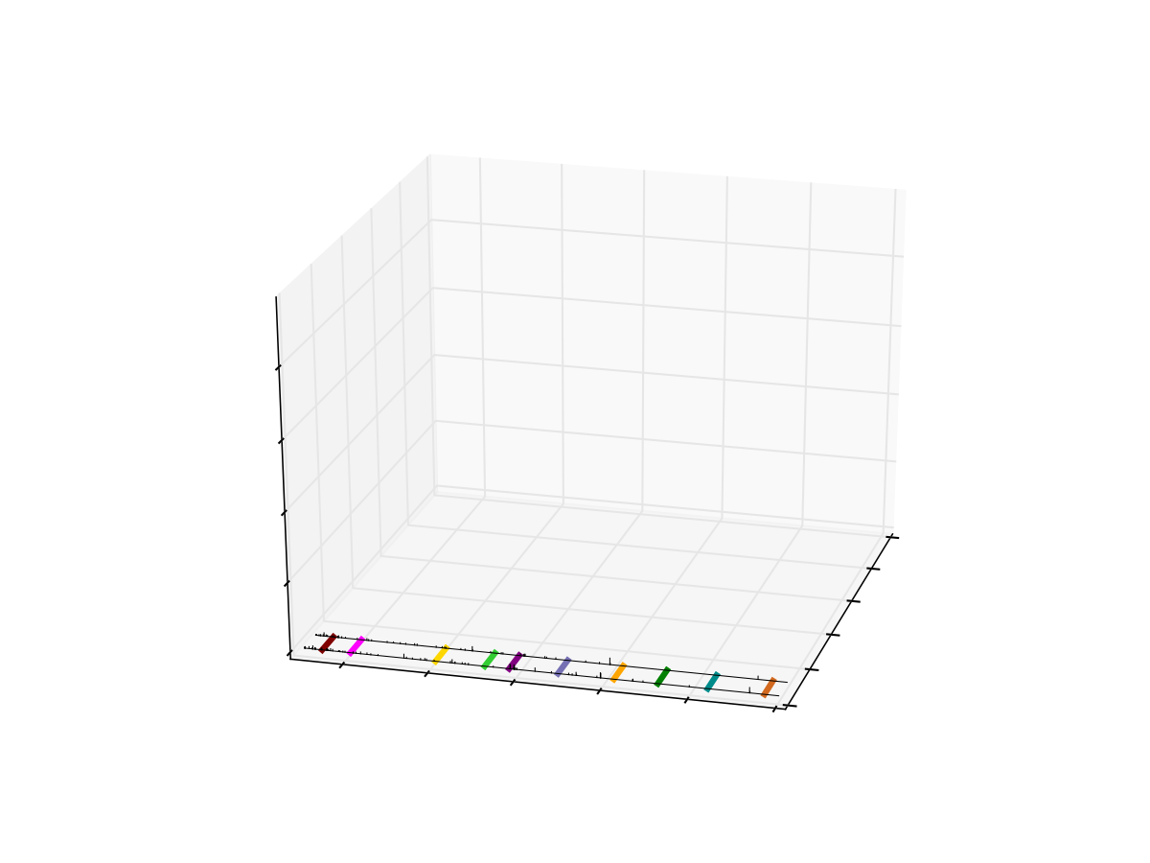
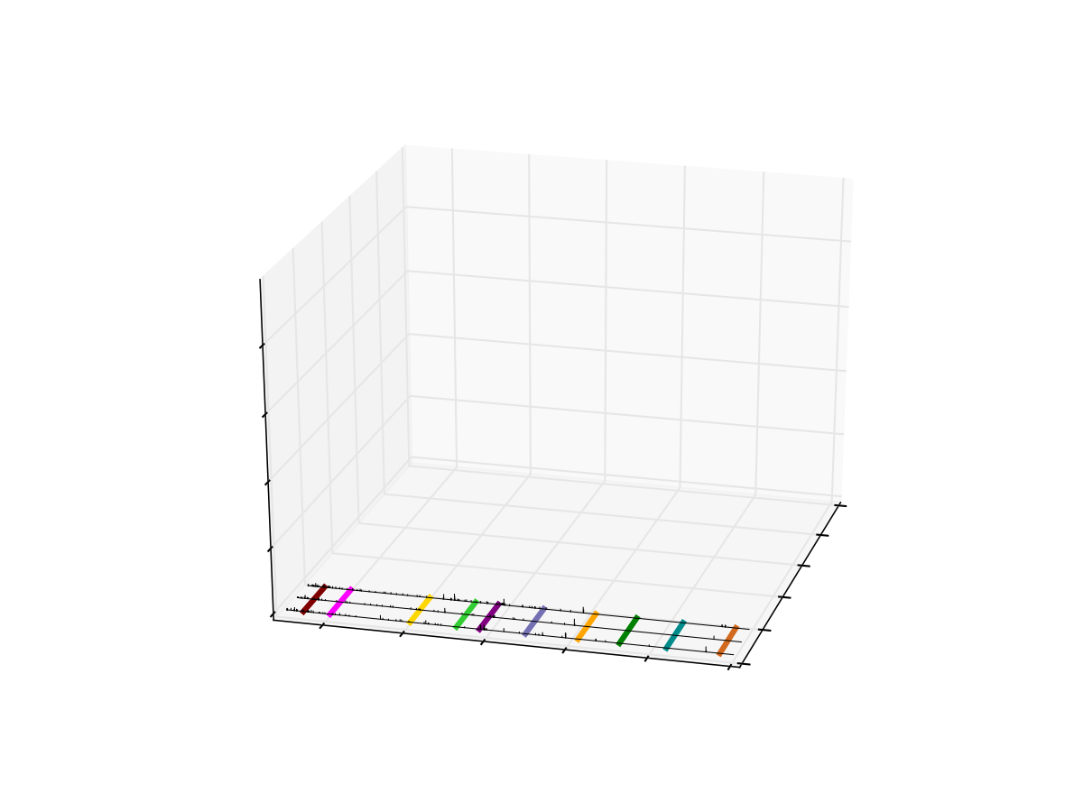
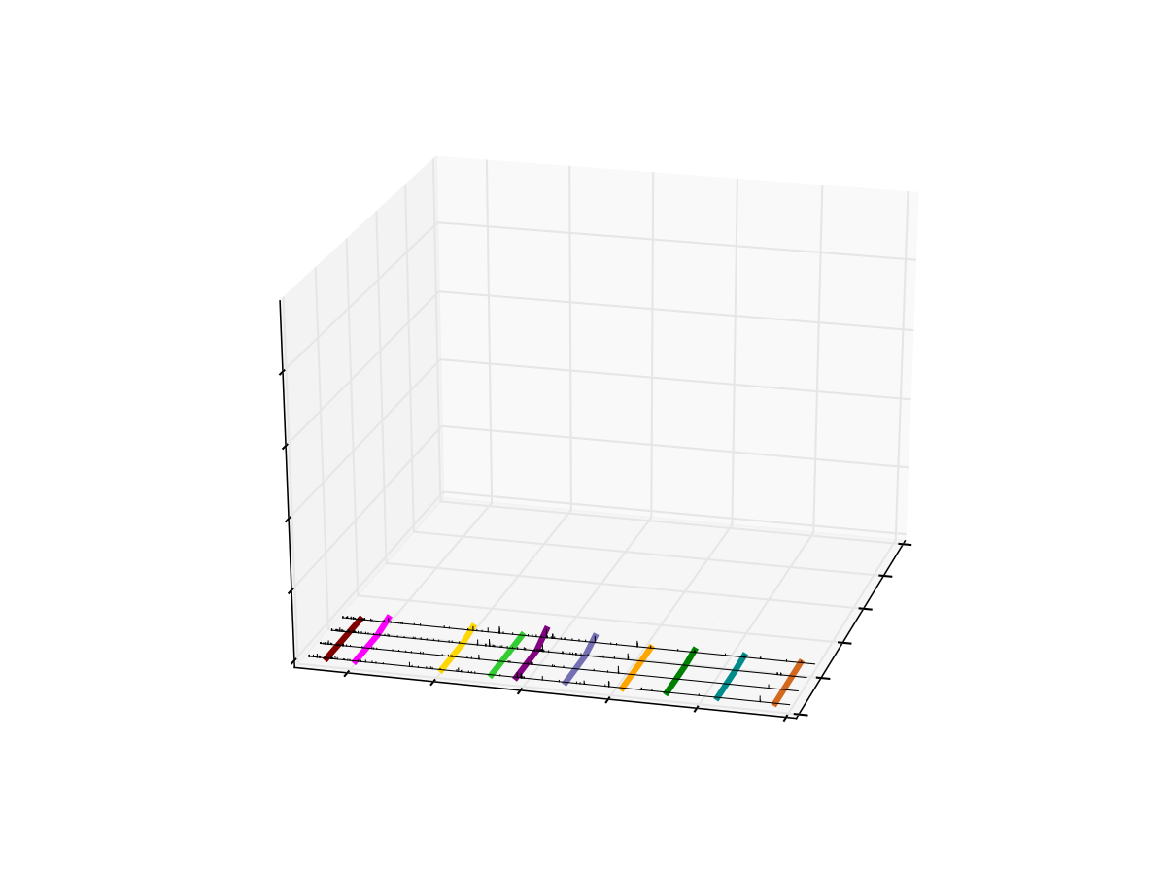
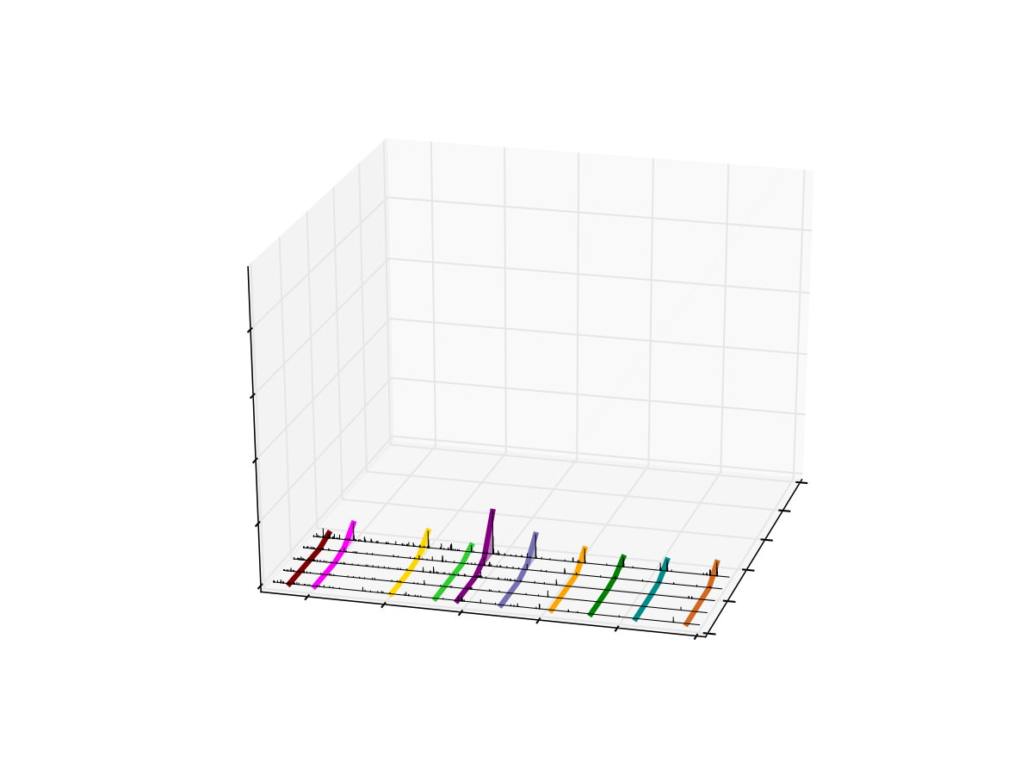
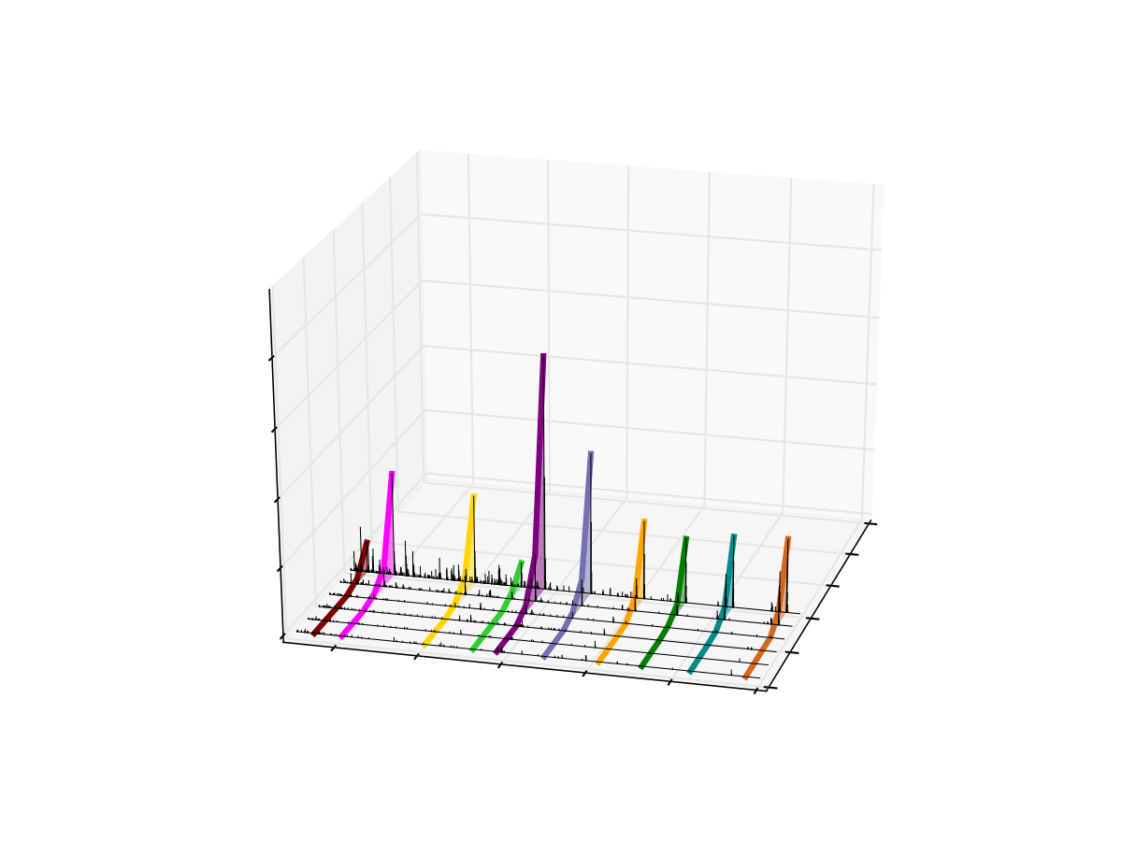
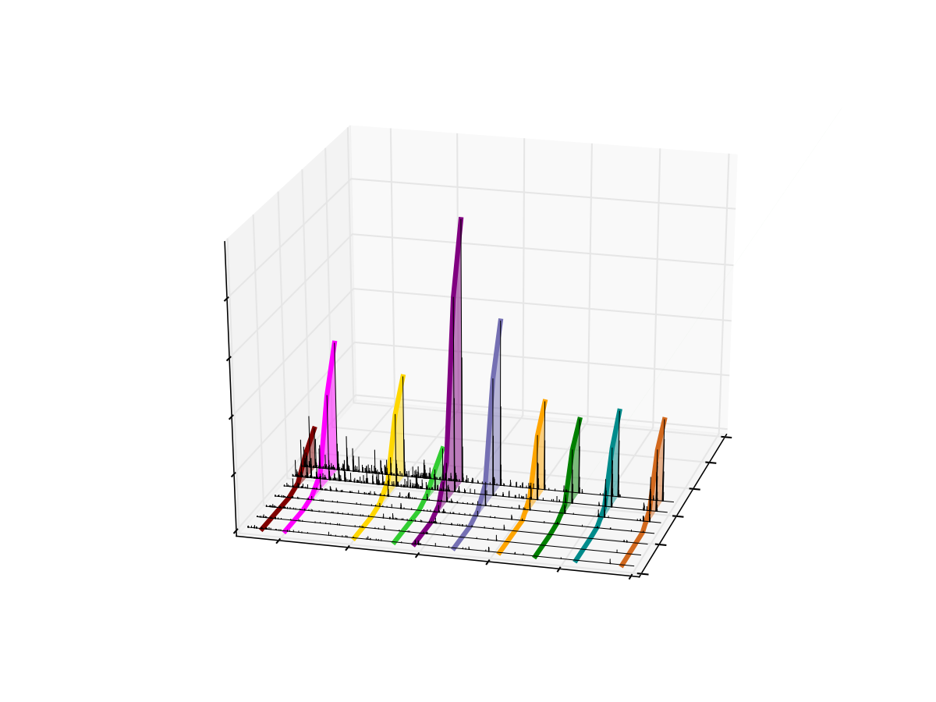
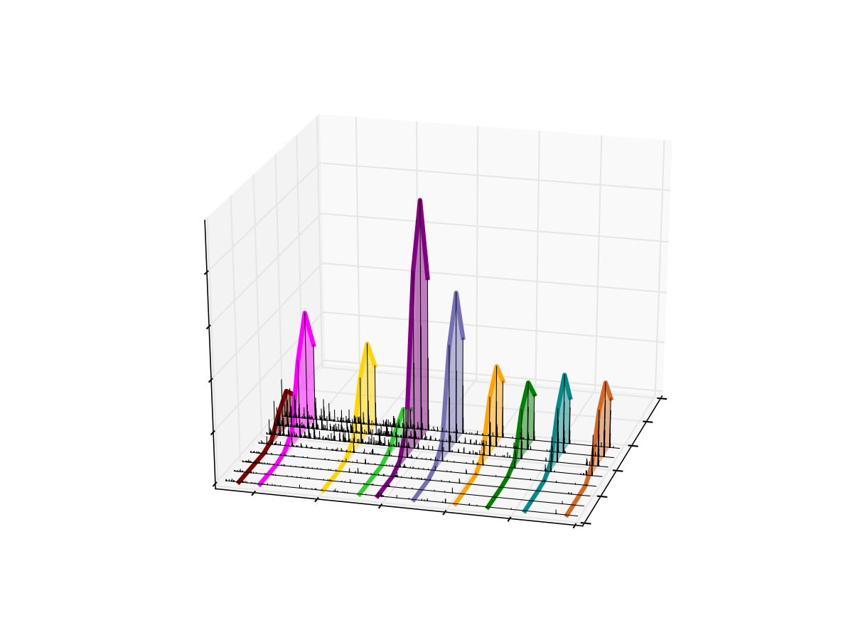
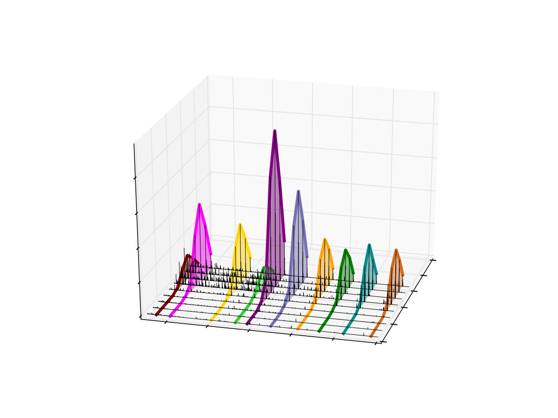
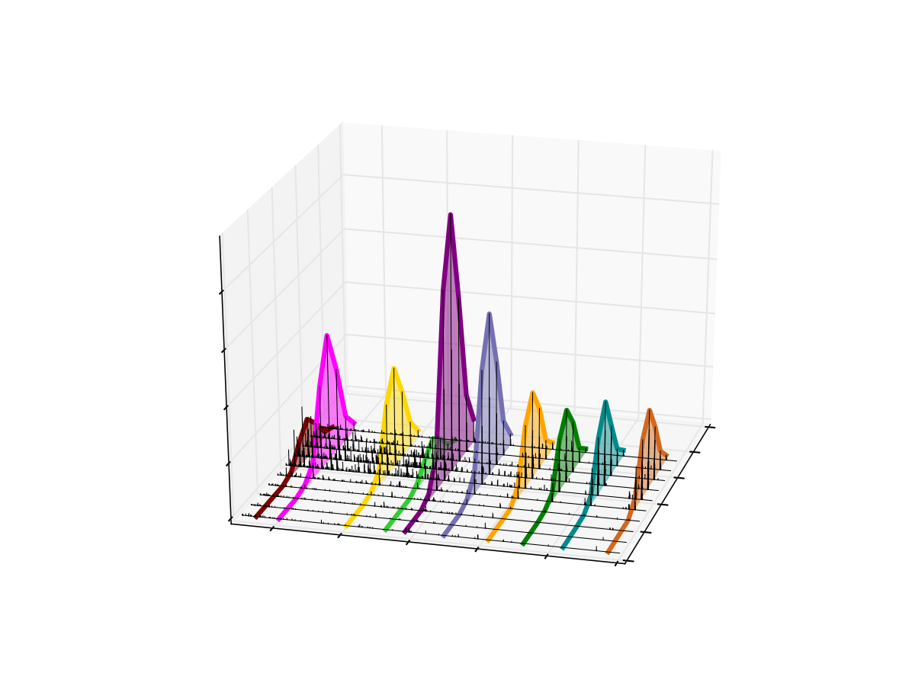
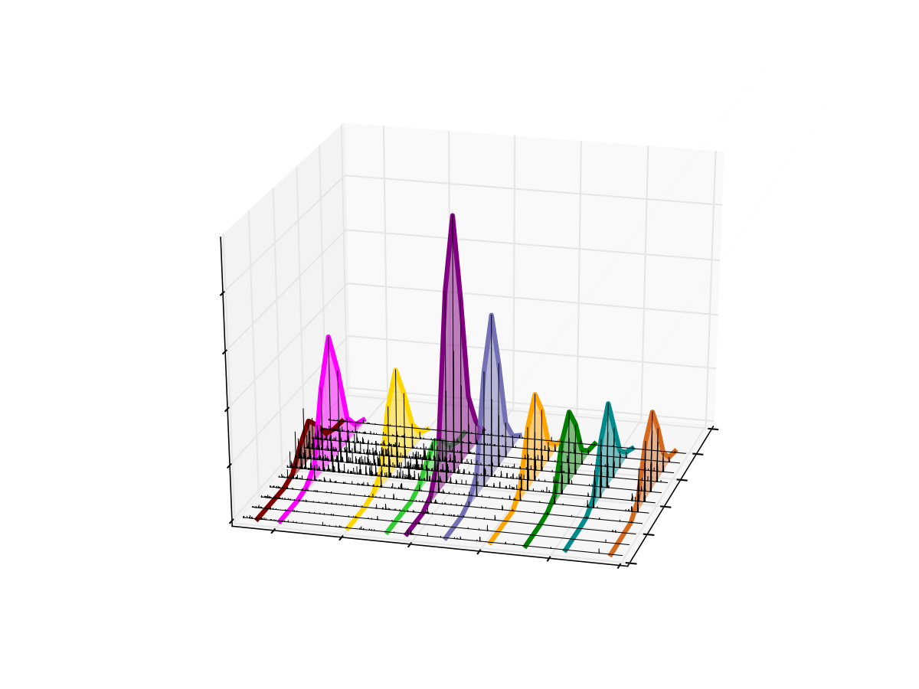

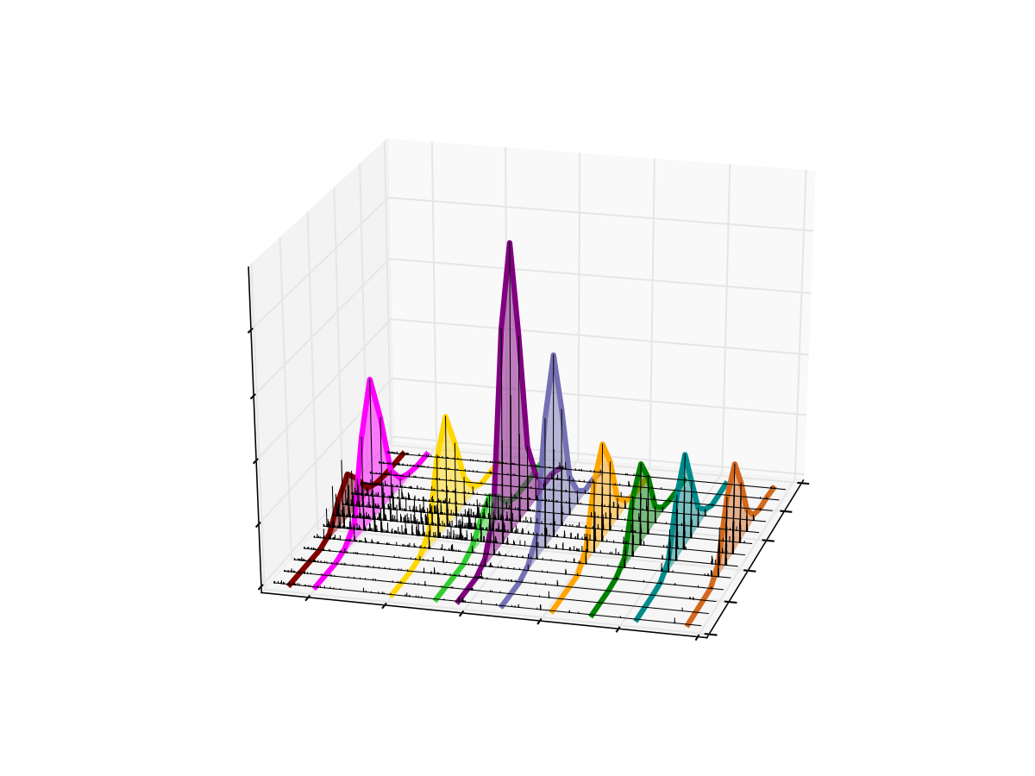
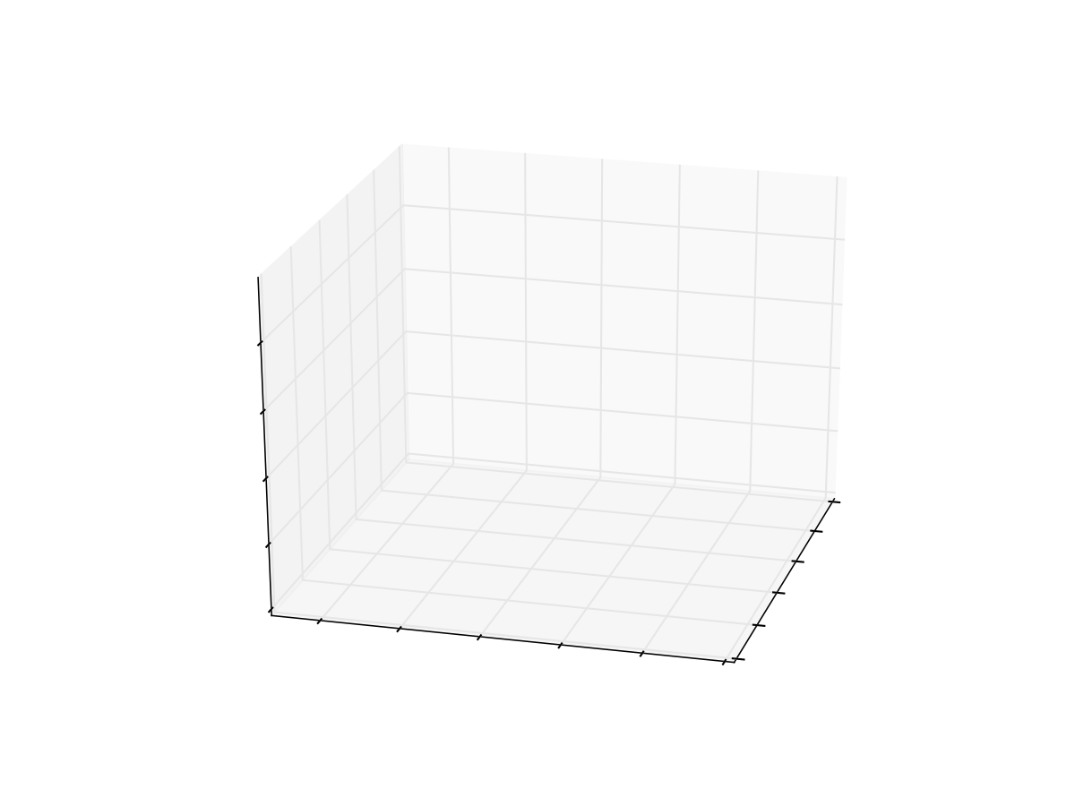
Extraction of Fragment Ions from DIA Data
500
m/z
900
4
3
Intensity x 10⁻⁵
2
51.7
51.6
1
51.5
51.4
0
Retention Time
400
51.3
600
800
1000
51.2
1200
1400
m/z
Venable et al Nat Methods 2004
Dong et al Science 2007

Slide 21
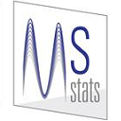

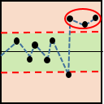
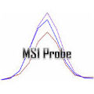
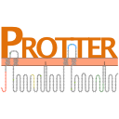
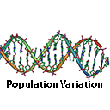
External Tools
Msstats (Vitek)
QuaSAR (Carr)
SProCoP (Bereman)
3946 Downloads!
1271 Downloads!
919 Downloads
grouped study statistics
response curve statistics
system suitability
MS1 Probe (Gibson)
Protter (Wollscheid)
Population Variation
962 Downloads!
363 Downloads!
208 Downloads!
MS1 filtering statistics
transmembrane topology
mutation frequency
Broudy, et. al, submitted to Bioinformatics

Slide 22
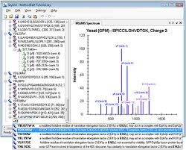
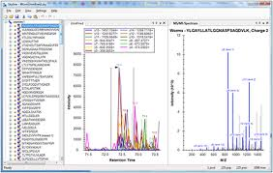
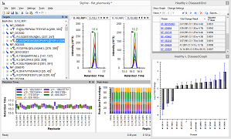
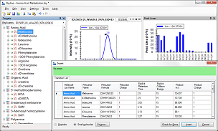
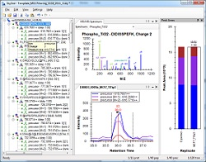
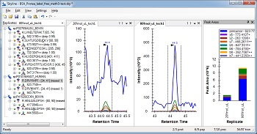
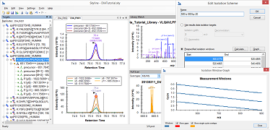
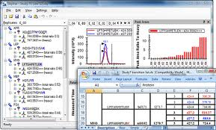
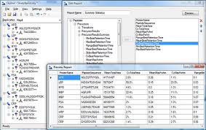
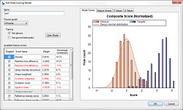
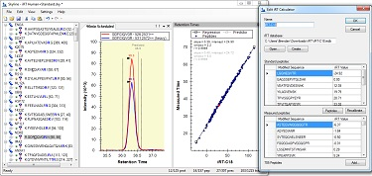
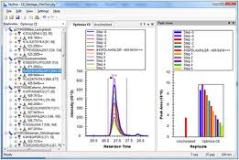
14 Tutorials (5 translated)
Method Editing
Method Refinement
Grouped Studies
Small Molecule
New webinar!
New webinar!
New webinar!
New webinar!
MS1 Filtering
Targeted MS/MS (PRM)
DIA with DDA
Existing Experiments
New webinar!
New webinar!
New webinar!
Custom Reports
Advanced Peak Picking
iRT
CE Optimization
New webinar!
New webinar!
Growing…

Slide 23

Aggregating and Publishing
Publish fully annotated Skyline documents
Build chromatogram libraries
Aggregate lab QC data
Free hosted version (http://panoramaweb.org)
228 labs so far (including large projects from LINCS, CPTAC, & ABRF sPRG)
>9589 data sets uploaded
User controlled security
Built on LabKey Server
Locally installable server application
Panorama Public supports the most recent MCP guidelines for reporting quantitative results
Panorama Partners – Four Pharma Companies and NCI CPTAC
Free and open source (Apache 2.0)
Sharma, et. al, J. Proteome Res. 2014
Notes:
Goals, customers and likely users

Slide 24
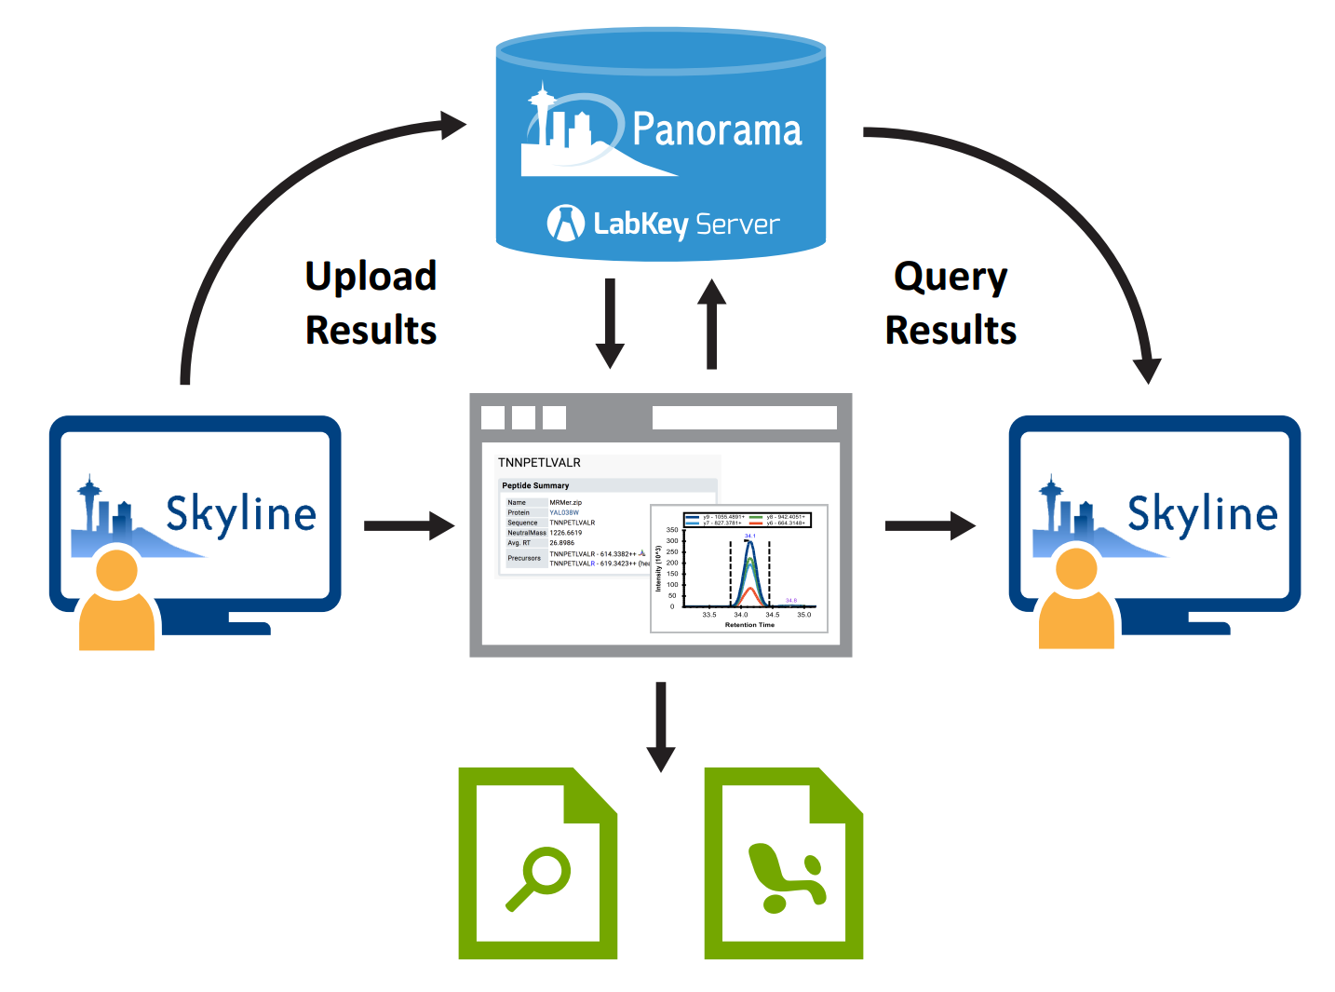
Panorama Growth High

Slide 25
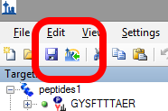
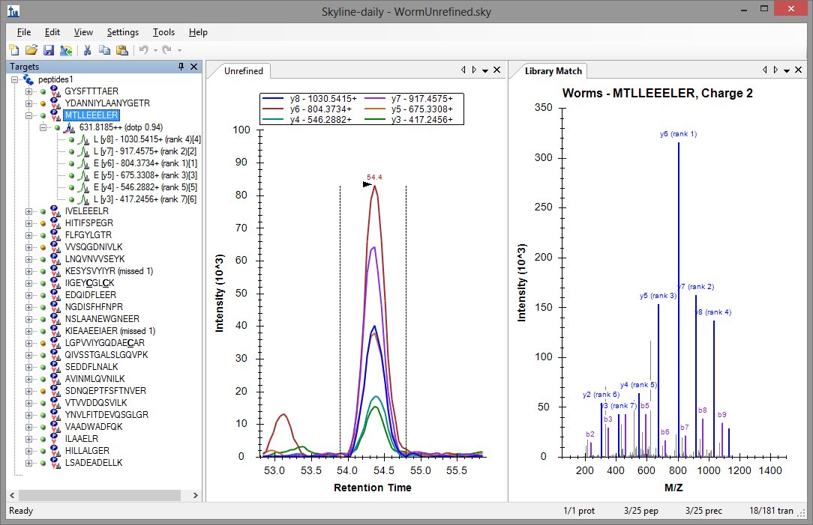
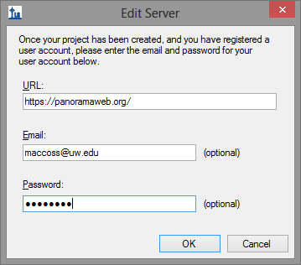
What do you do with these documents?

Slide 26
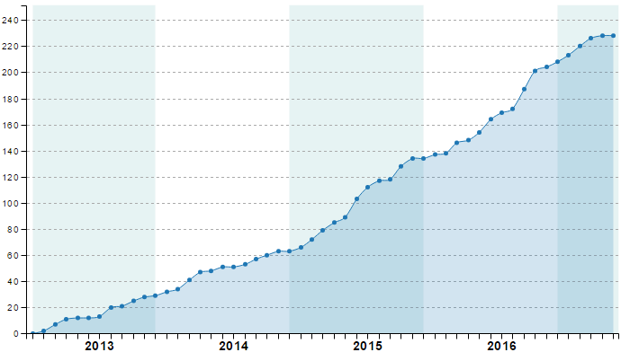
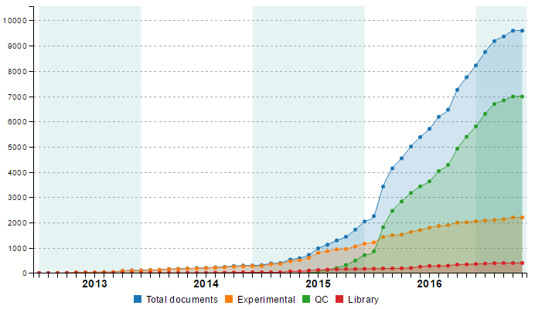
Growth of PanoramaWeb
Lab Growth to 228
Skyline docs to 9589

Slide 27
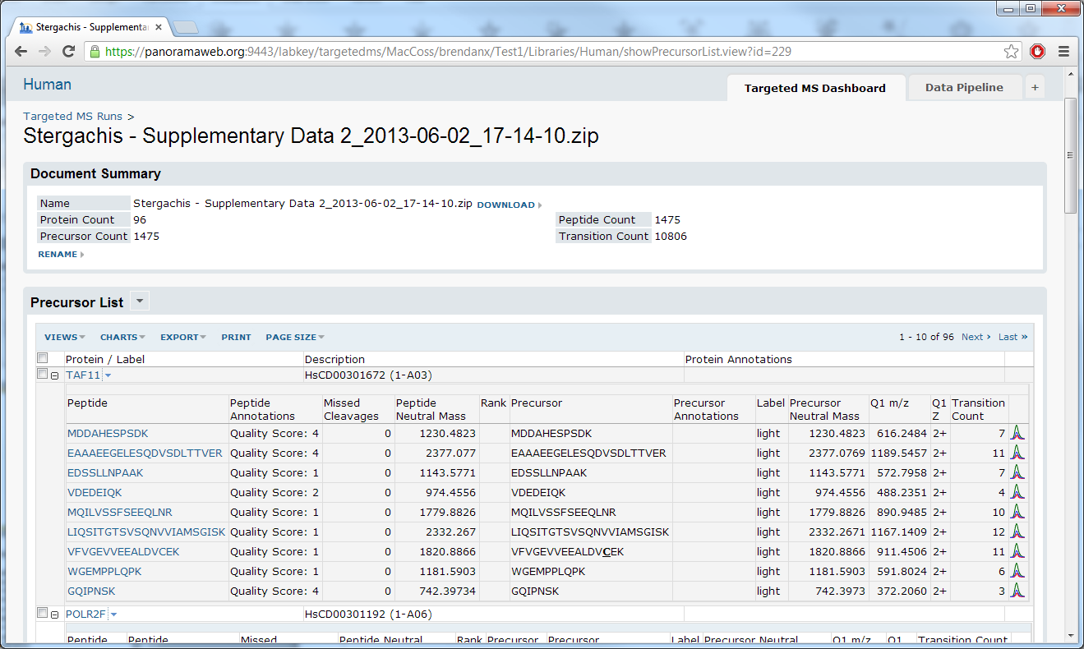
Viewing Runs - Peptides
Notes:
Mention that we’re now on the web site.
Here’s another protein from the same document.

Slide 28
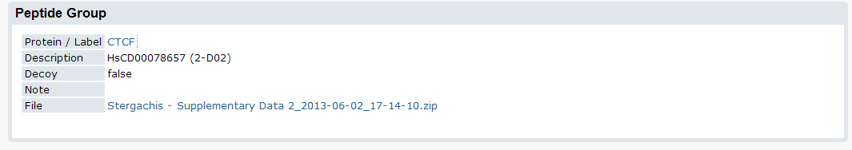



Viewing Proteins

Slide 29




Viewing Peptides
Notes:
Switching to different document, with replicates.
“Condition” is a replicate annotation (added in the last year), and it’s available here for grouping purposes.

Slide 30










Customizing Views, Sorts, Filters

Slide 31

The LINCS Data is Available Through Panorama

Slide 32

Panorama has Extensive API Support

Slide 33


Backend to NIH Branded Sites
NCI CPTAC Assay Portal
LINCS pilincs.org

Slide 34


http://passport.maccosslab.org

Slide 35




Panorama Public is a Place to Share Quantitative Results

Slide 36

Grouth Partially Enabled by AutoQC

Slide 37

Vendor Neutral AutoQC
Automation of CPTAC System Suitability Process

Slide 38

Data Uploaded Automatically to Panorama

Slide 39

Track Performance Overtime

Slide 40
New Paradigm for Data Processing
Proteomics data needs to be “un-siloed”
A single place for all data
Volume of high value data is increasing
Crucial for peer review and critical analysis
Economics are driving demand for data reuse
Cultural shift: Public access to data collected with public funds
We need to bring algorithms to the data

Slide 41




Managed by Stratus Biosciences – A Non-Profit Company
http://chorusproject.org

Slide 42



Nate Yates
Chris Wu
Andrey Bondarenko
http://chorusproject.org

Slide 43



Chorus Project
http://chorusproject.org

Slide 44


Sharing and Dissemination of RAW Data

Slide 45

Vendor Neutral Chromatogram and Spectrum Viewer

Slide 46



Instruments and Operators

Slide 47

Automatic Upload / Desktop Client
Link

Slide 48




Each instrument has an automatic client uploader

Slide 49



Organizing Data

Slide 50

Support Wiki Pages for Projects

Slide 51


Sharing Data and Projects

Slide 52
Proteomics Analysis Tools in Development
Database Search Engines
Comet (SEQUEST) and Percolator
Byonic
MaxQuant
Quantitation
Skyline
MaxQuant
dMS
Data Independent Acquisition
Skyline/mProphet
PECAN/EncyclopeDIA

Slide 53




Running Processing

Slide 54



Analyzing Data

Slide 55

Data Archival

Slide 56
Plans – Big Data Analysis
Linking data to each other in CHORUS
Who has seen my favorite peptide before?
Are there similar experiments to mine?
Who has reagents for my proteins?
What are the most frequently collected MS/MS spectra that have never been assigned an identification

Slide 57
Creating an Ecosystem of Free Professionally Developed Tools to Advance Proteomics

Slide 58
Acknowledgement
Stratus Biosciences
Andrey Bonderenko
Christine Wu
Nathan Yates
University of Washington
Department of Genome Sciences
Josh Akey
Bill Noble
John Stamatoyannopolous
Judit Villen
UW Lab Medicine
Andy Hoofnagle
Geoff Baird
Clark Henderson
The Broad
Jake Jaffe
LabKey Software
Josh Eckels
Stanford
Tom Montine
CorSolutions
Tom Corso
Colleen Van Pelt
UW Proteomics Resource
Jimmy Eng
Priska von Haller
University of Washington
MacCoss Lab
Yuval Boss
Nat Brace
Jarrett Egertson
Jason Gilmore
Austin Keller
Rich Johnson
Brendan MacLean
Gennifer Merrihew
Brook Nunn
Lindsay Pino
Brian Pratt
Brian Searle
Vagisha Sharma
Nick Shulman
Sandi Spencer
Emma Timmins-Schiffman
Sonia Ting
Han-Yin Yang
Financial Support
NIA / NIH
NIGMS / NIH
NIGMS / NIH Yeast Resource Center
NCI / NIH
NIH / Common Fund
NIA / Nathan Shock Center
Vendor Financial Support
Agilent Shimadzu
Bruker ThermoFisher
Sciex Waters

Slide 59

MacCoss Lab UW

